Slide 1

Quick Surge Price Prediction for Cab aggregator
JanataHack: Mobility Analytics

Slide 2

Introduction
With the upcoming cab aggregators and demand for mobility solutions, the past decade has seen immense growth in data collected from commercial vehicles with major contributors such as Uber, Lyft and Ola to name a few.
There are loads of innovative data science and machine learning solutions being implemented using such data and that has led to tremendous business value for such organizations.
This is a Hackathon relating to Mobility Business conducted by Analytics Vidhya. This presentation is about my attempt in tackling the challenge

Slide 3
Problem Statement
Welcome to Sigma Cab Private Limited - a cab aggregator service. Their customers can download their app on smartphones and book a cab from any where in the cities they operate in. They, in turn search for cabs from various service providers and provide the best option to their client across available options. They have been in operation for little less than a year now. During this period, they have captured surge_pricing_type from the service providers.
You have been hired by Sigma Cabs as a Data Scientist and have been asked to build a predictive model, which could help them in predicting the surge_pricing_type pro-actively. This would in turn help them in matching the right cabs with the right customers quickly and efficiently.

Slide 4
Problem Statement
Welcome to Sigma Cab Private Limited - a cab aggregator service. Their customers can download their app on smartphones and book a cab from any where in the cities they operate in. They, in turn search for cabs from various service providers and provide the best option to their client across available options. They have been in operation for little less than a year now. During this period, they have captured surge_pricing_type from the service providers.
You have been hired by Sigma Cabs as a Data Scientist and have been asked to build a predictive model, which could help them in predicting the surge_pricing_type pro-actively. This would in turn help them in matching the right cabs with the right customers quickly and efficiently.

Slide 5
Preliminary Understanding
Train and Test data shows similar pattern in their mean and quartile distribution. This is great. We can assume that the test data is similar to that of train and predictions on Train might work on Test
Train and Test have no empty Train_ID, Train_Distance
We have few NaN in Type_of_Cab for both Train and Test. Lets create a new category ‘F’ with all the NaN values
Customer_Since_Months has few NaN values and replace them with 0. They are the newbies to this cab services.
Life_Style_Index, Confidence_Life_Style_Index. This is a propritery value by the cab company and we have no idea how it is derived. Can think of omitting the NaN rows. Since, replacing them with 0 might mean something different. Or, can perform EDA and decide later.
Destination_Type, Customer_Rating, Cancellation_Last_1Month have no missing values.
Var1 is masked by the company and is very sparse. We definitely cant remove all records with NaN values and neither assume them to be 0. we could take a call on this after EDA.

Slide 6
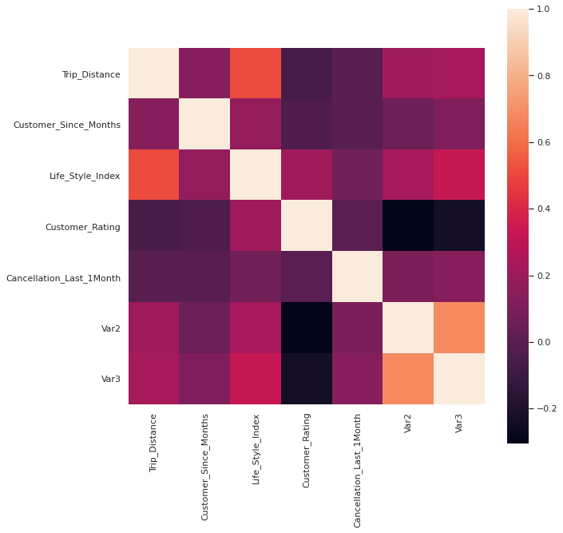
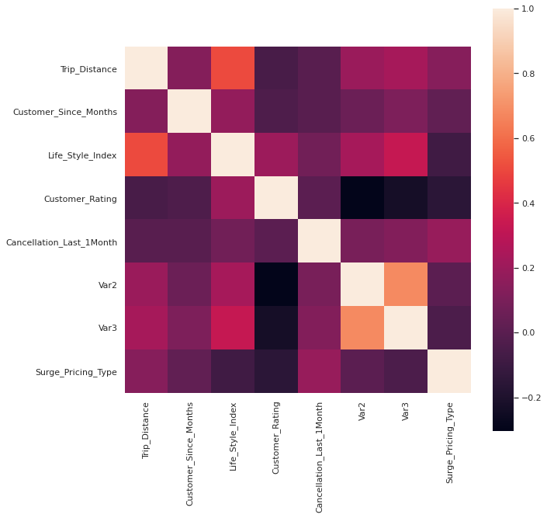
Correlation check
Can see Var2 and Var3 correlated in both Test and Train and have removed Var2

Slide 7
Preliminary Understanding
Train and Test data shows similar pattern in their mean and quartile distribution. This is great. We can assume that the test data is similar to that of train and predictions on Train might work on Test
Train and Test have no empty Train_ID, Train_Distance
We have few NaN in Type_of_Cab for both Train and Test. Lets create a new category ‘F’ with all the NaN values
Customer_Since_Months has few NaN values and replace them with 0. They are the newbies to this cab services.
Life_Style_Index, Confidence_Life_Style_Index. This is a propritery value by the cab company and we have no idea how it is derived. Can think of omitting the NaN rows. Since, replacing them with 0 might mean something different. Or, can perform EDA and decide later.
Destination_Type, Customer_Rating, Cancellation_Last_1Month have no missing values.
Var1 is masked by the company and is very sparse. We definitely cant remove all records with NaN values and neither assume them to be 0. we could take a call on this after EDA.

Slide 8
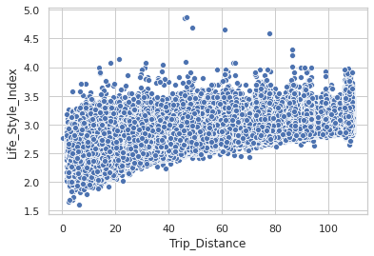
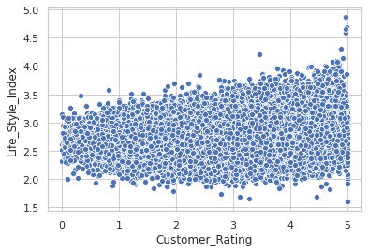
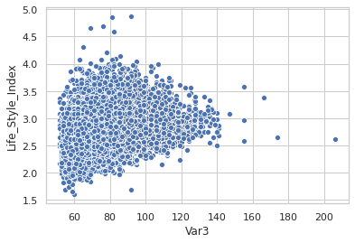
EDA to understand Life_Style_Index
From the 3 scatter plots, we can notice that most of the values of Life_style_index is distributed between 2 to 3.5
For simplicity, we fill assume NaN values with mode values for both Train and Test(2.7)

Slide 9
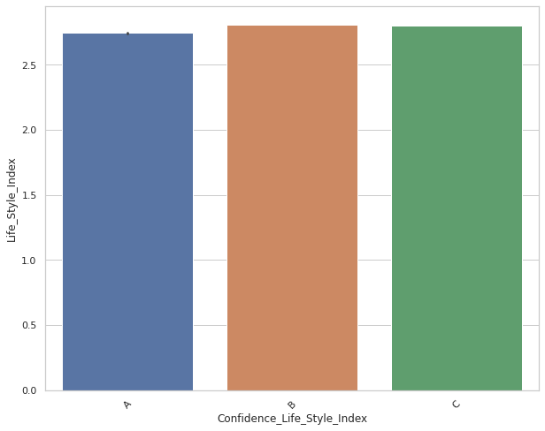
EDA to understand Confidence_Life_Style_Index
Look like the Confidence_Life_Style_Index is randomly assigned with equal distribution. For simplicity, lets equally assign A,B,C to the NaNs in the field.

Slide 10
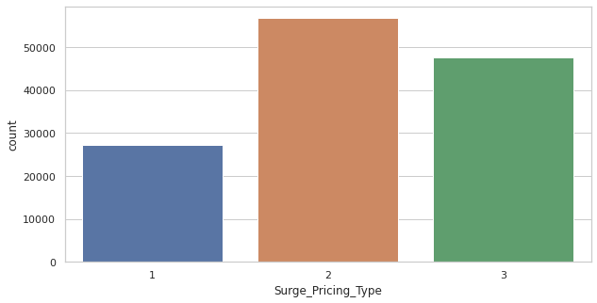
EDA on Surge_Pricing_Type
Not a large difference between the target values, and Sampling isn't required.

Slide 11
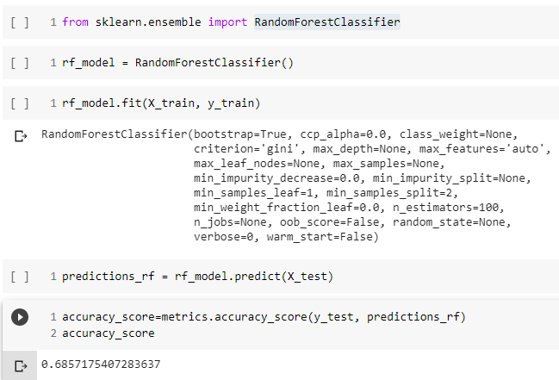
Modeling: RandomForestClassifier
1. Simple RandomForest gives Accuracy 0.685

Slide 12
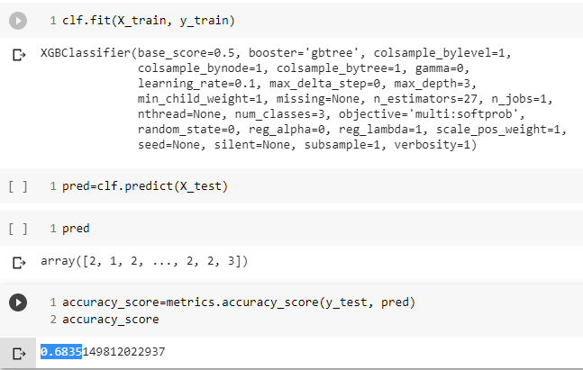
Modeling: XGBoost
1. Simple XGBoost gives Accuracy 0.6835

Slide 13
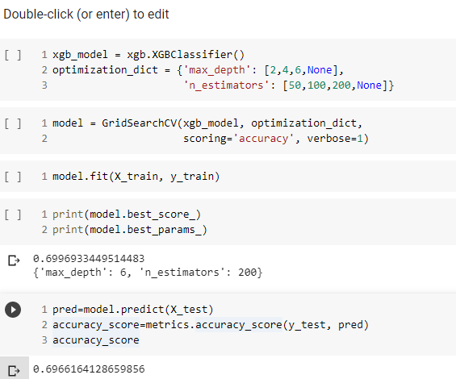
Modeling: XGBoost with GridSearchCV
1. XGBoost with GridSearchCV tuning gives Accuracy 0.696616 on Train data and 0.7015

